Slide 1
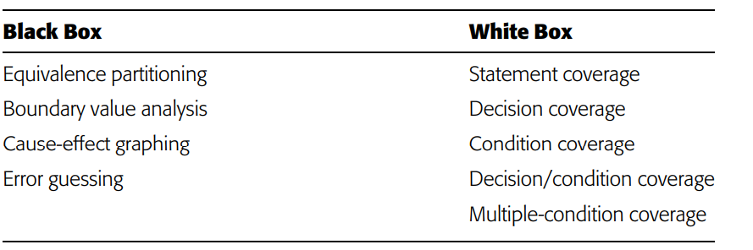
Chapter 3 – Test Case Design
What subset of all possible test cases has the highest probability of detecting the most errors?
Random -> worst strategy .. Will discuss these

Slide 2
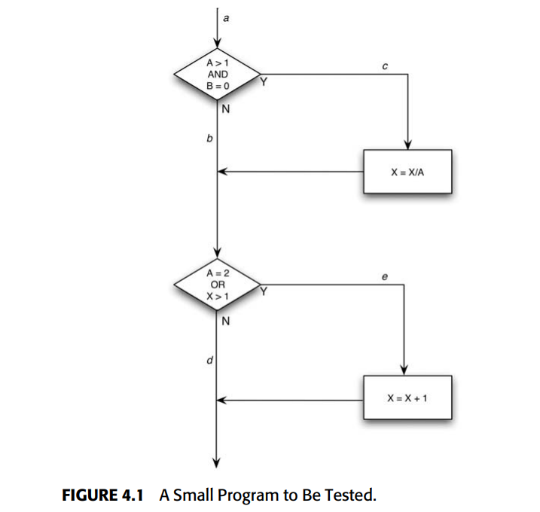
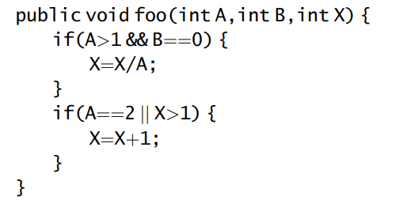
White Box Testing
White Box -> the degree to which test cases exercise or cover the logic (source code) of the program
setting A=2, B=0, and X=3
Exercises every path
But if there error was that should be
A>1 || B==0 … wouldnot really detect it

Slide 3
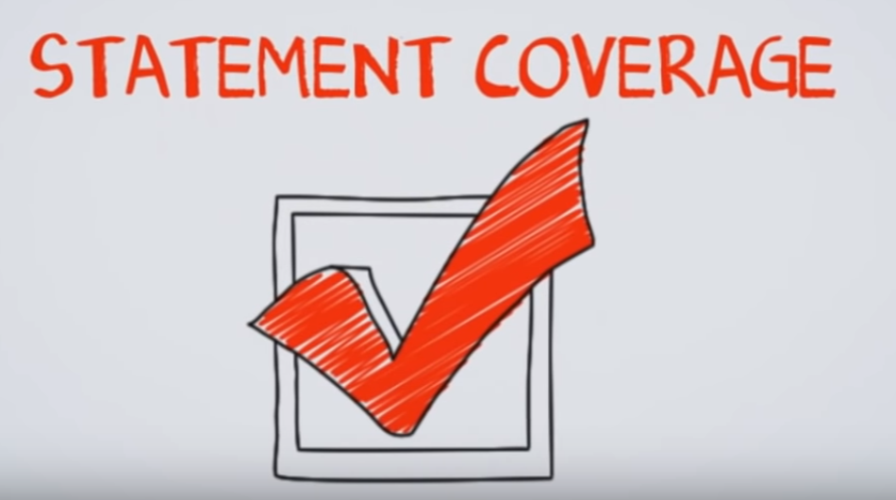
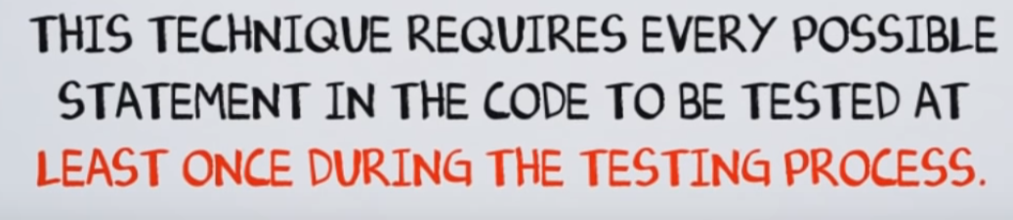

Slide 4
White Box Testing Limitation example
Module Specification:
Specification: input an integer and return ½ of its value
Developer takes int of n and therefore does not work for odd numbers correctly
def get_half( n ):
res = int(n/2)
return res
White box testing doesn’t look at spec …
*any* input can exercise the code
Blackbox would specifically select even and odd numbers

Slide 5



https://www.youtube.com/watch?v=9PSrhH2gtkU
Statement coverage:
If there is a statement in the code …need to cover it in a test
Coverage Measure … the higher this number the better

Slide 6



Goal to execute all branches in the code
You must write enough test cases that each decision has a true and a false outcome at least once.
In other words, each branch direction must be traversed at least once.
Branch: the outgoing edges of a decision
If statement
Switch Statement
While statement
For loop

Slide 7
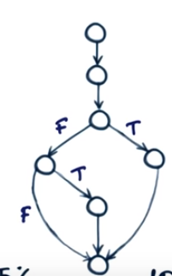


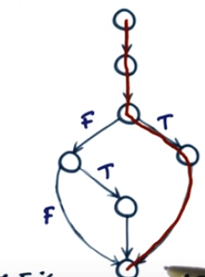
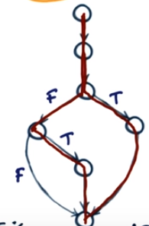

4 branches in this code
https://www.youtube.com/watch?v=JkJFxPy08rk
Module Specification: Don’t look at it
def print_sum( a, b ):
result = a + b
if result > 0:
print( f“Red:{result}”)
else if ( result < 0 ):
print(f“Blue:{result}“)
TC1 covers 1 branch
TC2 covers 2 branches – total 75% between the 2
Would need to add TC3 to get 100% coverage

Slide 8

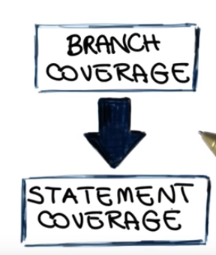
All test suites that satisfy 1 criterion also satisfies the other
Branch coverages is a stronger criterion
There is no way to cover all the branches
w/o also covering the statements
Statement coverages is a weaker criterion
Can cover all statements but not all branches
Branch coverage subsumes statement coverage
BRANCH COVERAGE IS MORE EXPENSIVE since requires a LARGER number of test cases

Slide 9
Branch coverage weakness
Sometimes appears to test everything but does not
By just exercising all branches … not necessarily testing all
Multi-condition
For programs containing decisions having multiple conditions,
Must test all possible condition combinations
at least once.

Slide 10

Testing based on program specifications
Black Box Testing Techniques – a few of the many
Equivalence Class Testing: It is used to minimize the number of possible test cases to an optimum level while maintains reasonable test coverage.
Boundary Value Testing: Boundary value testing is focused on the values at boundaries. This technique determines whether a certain range of values are acceptable by the system or not. It is very useful in reducing the number of test cases. It is most suitable for the systems where an input is within certain ranges.
Decision Table Testing: A decision table puts causes and their effects in a matrix. There is a unique combination in each column.

Slide 11
Equiveillance Class Partitioning
A huge number of possible inputs to test
Suppose have input number:
1,2,3,.................1,499,500.
is used to form groups of test inputs of similar behavior or attributes
test cases are designed and created based on each class attribute(s)
one element or input is used from each class for the test execution to validate the software functioning,

Slide 12
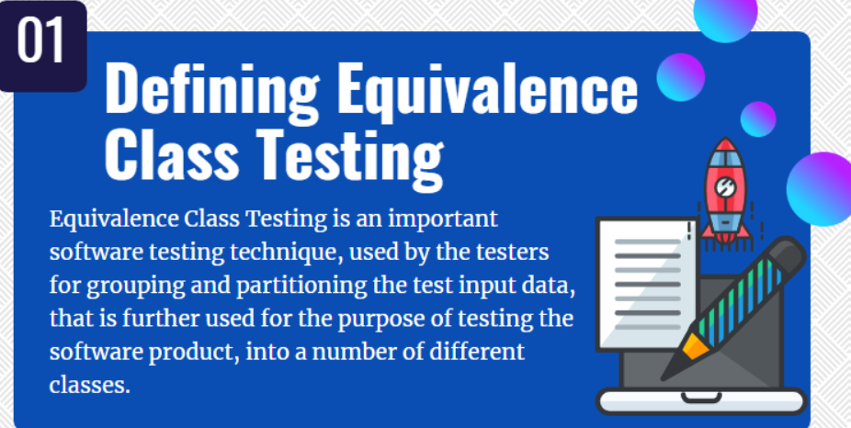
https://www.professionalqa.com/equivalence-class-testing
Improves test cases by removing vast # of redundancy and games

Slide 13
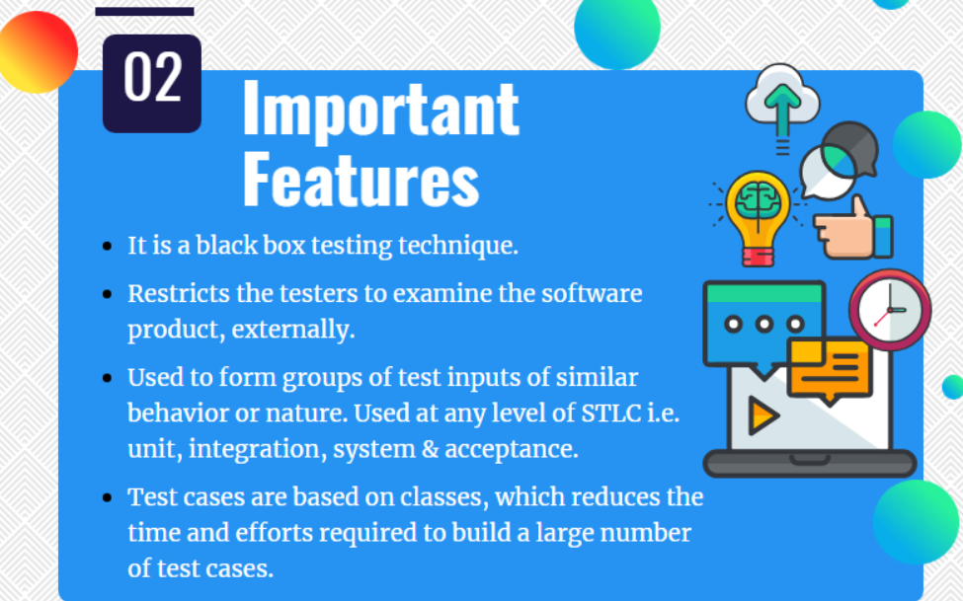

Slide 14
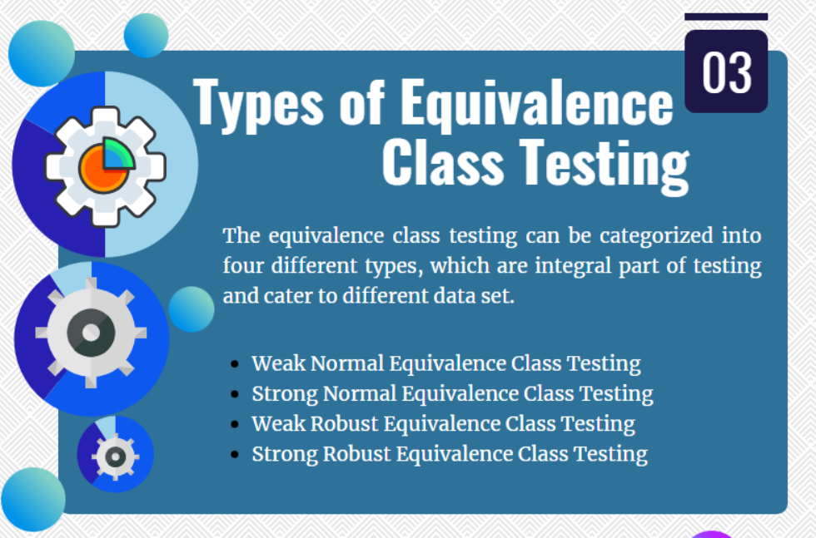

Slide 15
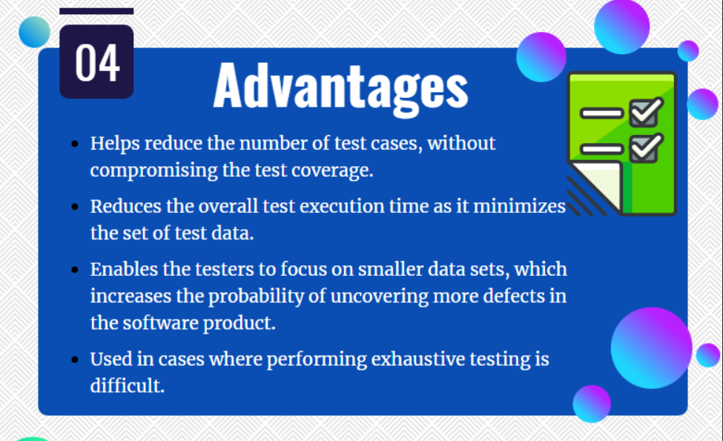

Slide 16
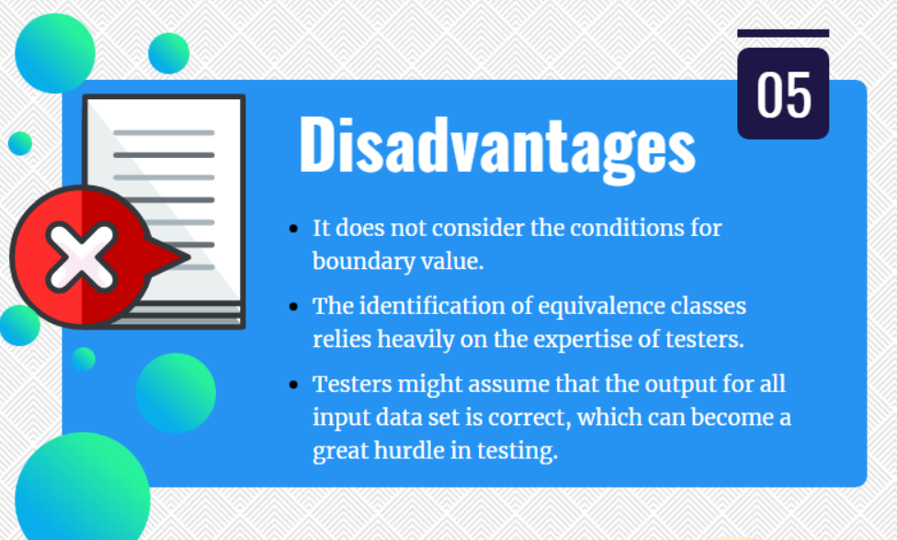

Slide 17
Equivalence Class Partition
https://www.professionalqa.com/equivalence-class-testing
You can apply this technique, where there is a range in the input field.
Ideally want the smallest number of tests with the highest probability of finding most errors
Test cases -> invoke as many different input considerations as possible to minimize the total number of test cases necessary
Well selected test cases:
Reduces the number of other test cases needed (by > 1 )
Covers a large set of test cases as possible
try to create a class sets (or groupings ) SO
Tests w/I group are redundant:
E.g.,
- If 1 test w/I group detects an error so would the other
- If 1 test does NOT detect error neither would the other
AKA - equivalence partitioning

Slide 18
Equivalence Class Partition
You can apply this technique, where there is a range in the input field.
What is Equivalent Class Partitioning?
Equivalent Class Partitioning -> Black Box can be applied to all levels of testing like unit, integration, system, etc.
Divide all test condition into a partition sets that can be considered the same.
It divides the input data of software into different equivalence data classes.

Slide 19
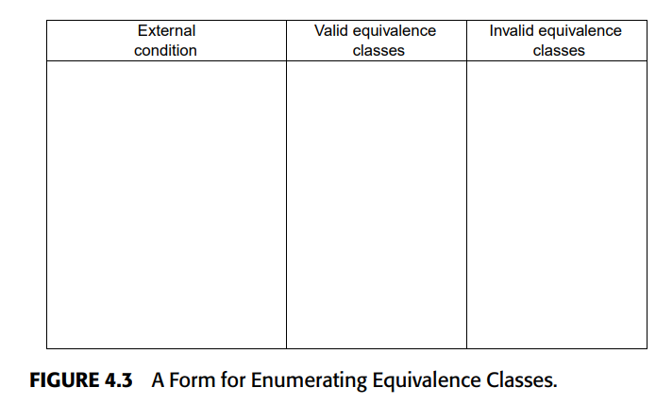
Need to do 2 things:
Identify the equivalence classes and
Define g the test cases.
Valid program group(s)
Error-bound groups
Input condition (E.g., title a string)

Slide 20
2. Identify the test cases
Until all classes covered
Valid Cases -> Write test case covering as many valid input equivalence classes as possible
Invalid classes -> Write test case covering 1 and only 1 invalid input equivalence classes as possible
E.g., if spec is
enter book type (HARDCOVER, SOFTCOVER, or LOOSE) and amount (1–999)enter book type (HARDCOVER, SOFTCOVER, or LOOSE) and amount (1–999)
Don’t use test case: type: “Blah” amount: 0
When this fails will not exercise this one

Slide 21
1. Identify Equivalence classes guidelines
the item count can be from 1 to 999
If input
involves a range
identify one valid equivalence class.
2. Involves a numeric set
identify one valid equivalence class and two invalid equivalence classes (no owners and more than six owners).
3. specifies a set of input values
identify a valid equivalence class for each and one invalid equivalence class (‘‘TRAILER,’’ for example).
4. specifies a ‘‘must-be’’ situation,
identify one valid equivalence class (it is a letter) and one invalid equivalence class (it is not a letter)
1-6 owners can be listed for the automobile
vehicle must be BUS, TRUCK, TAXICAB, PASSENGER, or MOTORCYCLE’’),
first character of the identifier must be a letter,
Otherwise -> If program does not handle elements in an equivalence class identically,
split the equivalence class into smaller equivalence classes

Slide 22
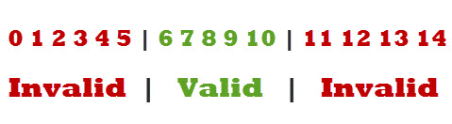
Example 1 ->text filed
Boundary Value Analysis and Equivalence Class Partitioning With Simple Example (softwaretestingclass.com)
A text field permits only numeric characters
Length must be 6-10 characters long
Partition according to the requirement
E.g., test 4 and 12 as invalid values and 7 as valid one.

Slide 23

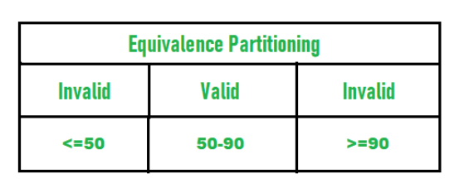
Example 2-
accept percentage only between 50 to 90 %, more and even less than not be accepted

Slide 24

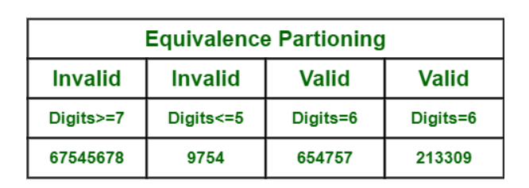
Example 3
Search accepts 6 and only 6 digits
I would probably make this something more unique like:
000000

Slide 25

Define Equivalence Partitioning with Examples (jobsandnewstoday.blogspot.com)
Savings Bank account
Interest rate: 3% - if Balance range of $0 to $100,
Interest rate: 5% - if balance range of $100 to $1000,
Interest rate: 7% - if balance $1000 and above.

Slide 26
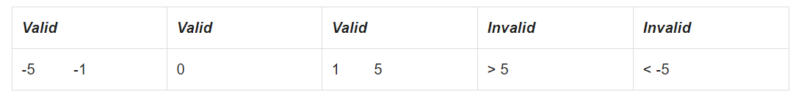
Example
is the same as 2,3,4,5
very value inside the partition is exactly equivalent to any other value as far as the program is concerned
testing with any one of these values is representative of the entire partition
E.g., -3 is exactly the same as -2, -1, -4, -5 and 2 is same as 1, 3, 4, 5

Slide 27
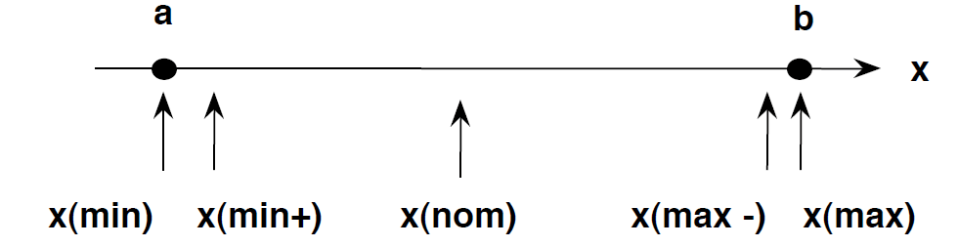
Boundary Value Analysis – test extreme ends of input values
https://www.guru99.com/equivalence-partitioning-boundary-value-analysis.html
Why: Exploring boundaries w/ tests have higher payoffs
Basic idea: Select input based on their –
Minimum
Just above minimum
A nominal value
Just below Max
Maximum
In Boundary Testing, Equivalence Class Partitioning plays a good role
Boundary Testing comes after the Equivalence Class Partitioning

Slide 28
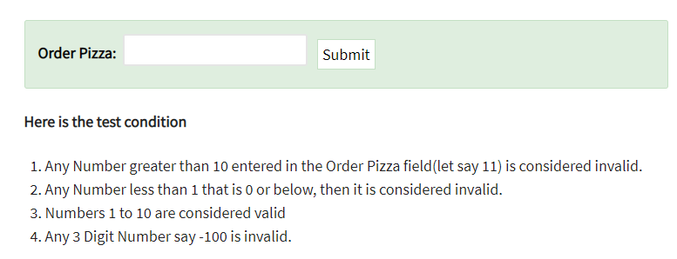
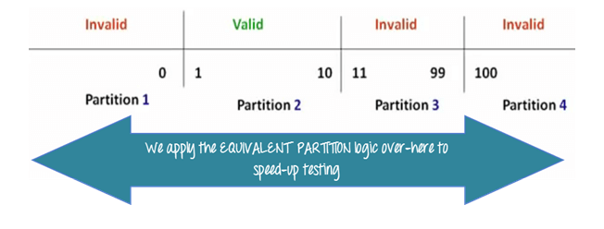
Basic idea:
if one condition/value in a partition passes all others will also pass.
Likewise, if one condition in a partition fails, all other conditions in that partition will fail.
we pick only one value from each partition for testing
Idea -> if one condition/value in a partition passes all others will also pass.
Likewise, if one condition in a partition fails, all other conditions in that partition will fail

Slide 29
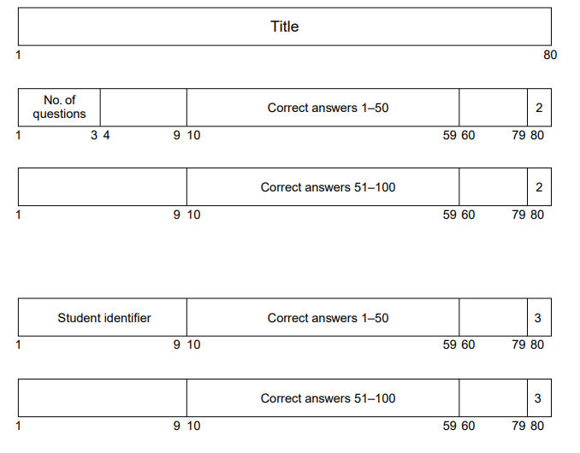
MTEST -> MC Test grader
Title on each output report.
describes the correct answers on the exam. These records contain a ‘‘2’’ as the last character
10–59 contain the correct answers for questions 1–50
correct answers for questions 51–100, 101–150, and so on
The maximum number of students is 200
‘‘3’’ in column 80.

Slide 30
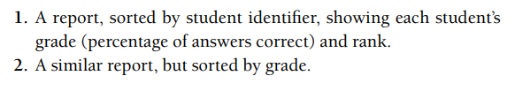
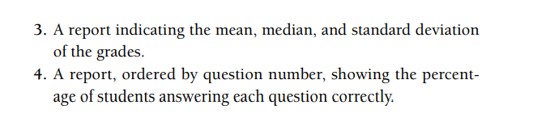
Program Output

Slide 31
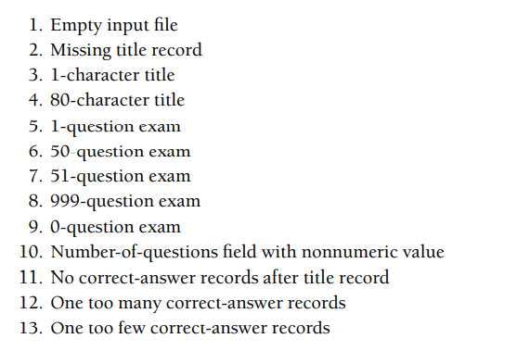
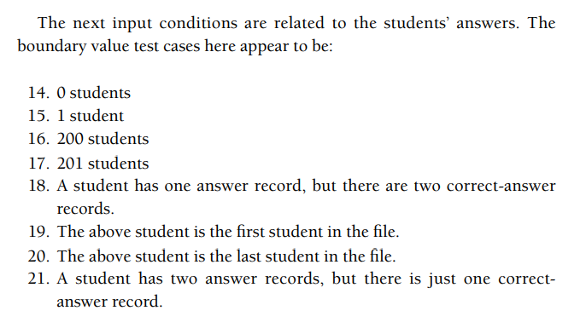

A reasonable partitioning of this into equivalence classes is 1–50 and 51–999. Hence, we need test cases where the number-of-questions field is set to 0, 1, 50, 51, and 999

Slide 32
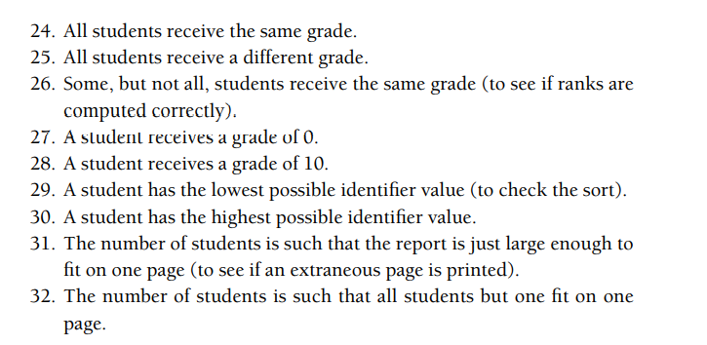
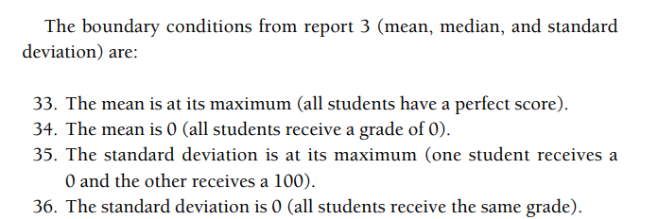

Slide 33
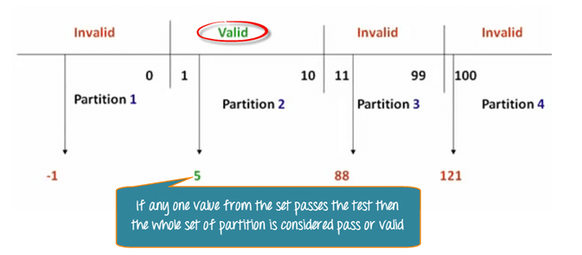
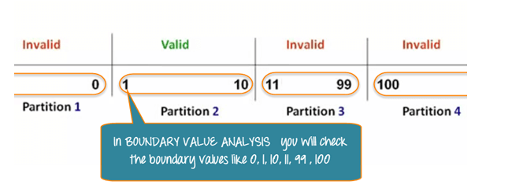
Boundary Value Analysis- in Boundary Value Analysis, you test boundaries between equivalence partitions

Slide 34
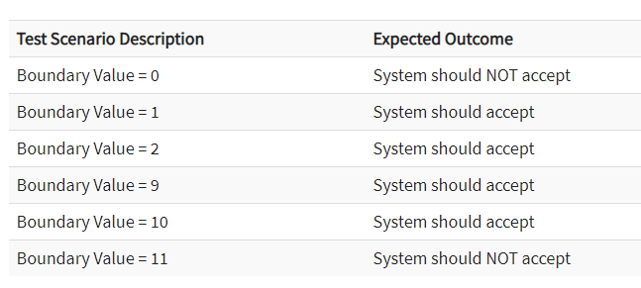
What is the boundary value test cases????
Input Box should accept the Number 1 to 10

Slide 35
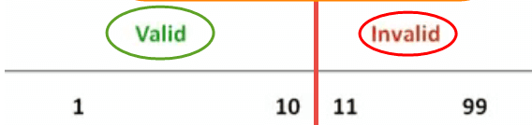
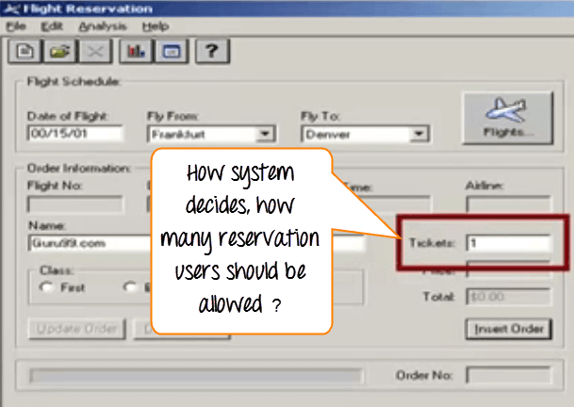
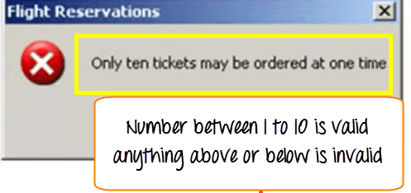
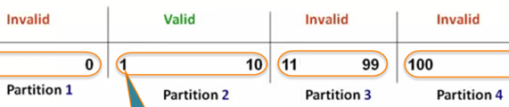
Example boundary Tests – boundary specifc
Consider a fight reservation system
- Valid # tickets only 1-10 (only 10 max at once)
In BVA check values at
Minimum
Just above minimum
A nominal value
Just below Max
Maximum
E.g., Pick 1 value from each of these classes to test with
100,
99
11 & 10
1 & 0

Slide 36
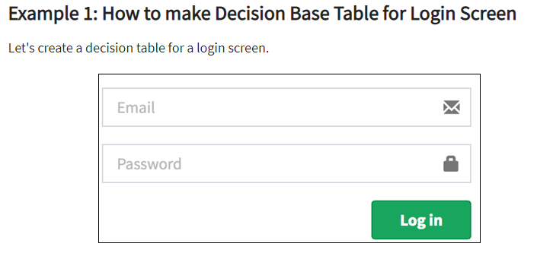
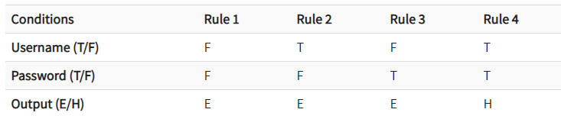
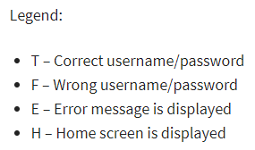
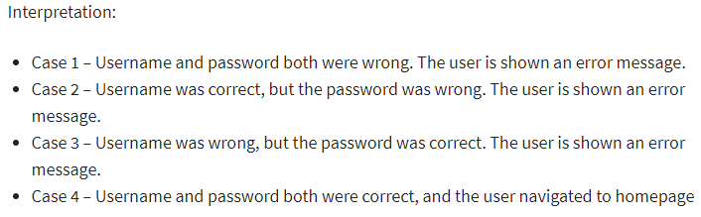
Decision Base Table Testing - testing technique used to test system behavior for different input combinations.
Create a table of different input combinations and the Output
https://www.guru99.com/decision-table-testing.html

Slide 37

upload photo dialog with certain conditions like:
You can upload only '.jpg' format image
file size less than 32kb
resolution 137*177.
If any of the conditions fails the system will throw corresponding error message stating the issue and if all conditions are met photo will be updated successfully
Conditions | Case 1 | Case 2 | Case 3 | Case 4 | Case 5 | Case 6 | Case 7 | Case 8
Format | .jpg | .jpg | .jpg | .jpg | Not .jpg | Not .jpg | Not .jpg | Not .jpg
Size | Less than 32kb | Less than 32kb | >= 32kb | >= 32kb | Less than 32kb | Less than 32kb | >= 32kb | >= 32kb
resolution | 137*177 | Not 137*177 | 137*177 | Not 137*177 | 137*177 | Not 137*177 | 137*177 | Not 137*177
Output | Photo uploaded | Error message resolution mismatch | Error message size mismatch | Error message size and resolution mismatch | Error message for format mismatch | Error message format and resolution mismatch | Error message for format and size mismatch | Error message for format, size, and resolution mismatch

Slide 38
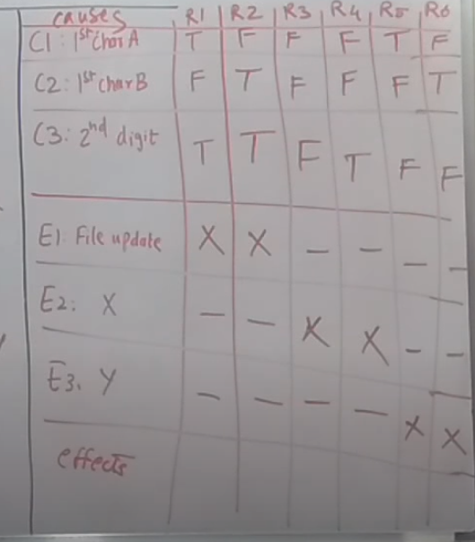
Read 2 characters and depending on the values -> print message
C1 -> "A" or "B"
C2 -> [0-9]
C3 -> If C1 and C2 true then FILE MUST BE UPDATED
C3 -> If C1 is false -> print XXXX
C4 -> If C2 is false print YYYY

Slide 39
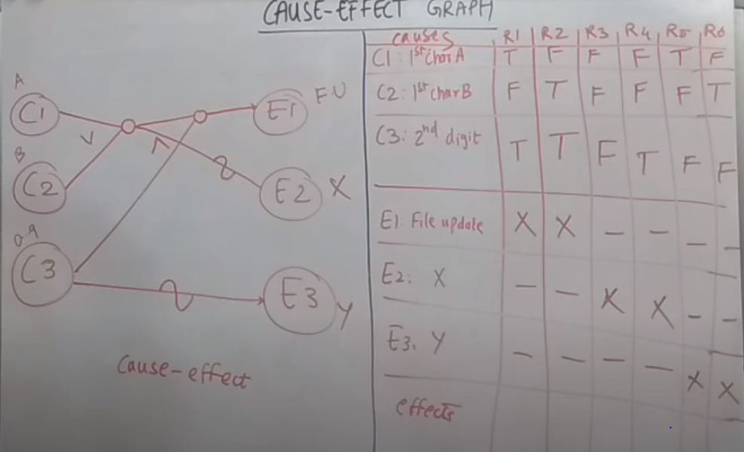

Slide 40
upload photo dialog with certain conditions like:
You can upload only '.jpg' format image
file size less than 32kb
resolution 137*177.
If any of the conditions fails the system will throw corresponding error message stating the issue and if all conditions are met photo will be updated successfully
Conditions | Case 1 | Case 2 | Case 3 | Case 4 | Case 5 | Case 6 | Case 7 | Case 8
Format | .jpg | .jpg | .jpg | .jpg | Not .jpg | Not .jpg | Not .jpg | Not .jpg
Size | Less than 32kb | Less than 32kb | >= 32kb | >= 32kb | Less than 32kb | Less than 32kb | >= 32kb | >= 32kb
resolution | 137*177 | Not 137*177 | 137*177 | Not 137*177 | 137*177 | Not 137*177 | 137*177 | Not 137*177
Output | Photo uploaded | Error message resolution mismatch | Error message size mismatch | Error message size and resolution mismatch | Error message for format mismatch | Error message format and resolution mismatch | Error message for format and size mismatch | Error message for format, size, and resolution mismatch

Slide 41
Error Guessing
Some people -> a knack for sniffing out errors.
Given a particular program, they surmise—both by intuition and experience—certain probable types of errors and then write test cases to expose those errors.
Idea -> make possible errors or error-prone situations and then write test cases based on the list.
E..g, the value 0,
try it with empty input
review specification look for gaps or possible misunderstandings
E.g., testing a sorting subroutine,
- The input list is empty.
- The input list contains one entry.
- All entries in the input list have the same value.
- The input list is already sorted
Enter Number of records: ________________
In other words, you enumerate those special cases that may have been overlooked when the program was designed

Slide 42
Example 2 – Binary search subroutine, you might try
there is only one entry in the table being searched;
the table size is a power of 2 (e.g., 16); and
the table size is one less than and one greater than a power of 2 (e.g., 15 or 17).
No input at all

Slide 43
MTEST -> MC Test grader
Title on each output report.
describes the correct answers on the exam. These records contain a ‘‘2’’ as the last character
10–59 contain the correct answers for questions 1–50
correct answers for questions 51–100, 101–150, and so on
The maximum number of students is 200
‘‘3’’ in column 80.

Slide 44
Consider the MTEST program in the section on boundary value analysis.
Might guess:
1. Does the program accept ‘‘blank’’ as an answer?
2. A type-2 (answer) record appears in the set of type-3 (student) records.
3. A record without a 2 or 3 in the last column appears as other than the initial (title) record.
4. Two students have the same name or number.
5. Since a median is computed differently depending on whether there is an odd or an even number of items, test the program for an even number of students and an odd number of students.
The number-of-questions field has a negative value. Error-guessing tests that come to mind for the DISPLAY command of the previous section are as follows: DISPLAY 100- (partial second operand) DISPLAY 100. (partial second operand) DISPLAY 100–10A 42 (extra operand) DISPLAY 000–0000FF (leading zeros)

Slide 45
Why is Decision Table Testing is important?
Use when – need to test different combination.
In particular => when each set of input values the system behavior is different,

